Slide 1


Slide 2
Content
Introduction
Categories of Cyber crime
Types of Cyber crime
Types of Security tools
Advantage of Cybersecurity
Safety tips to Cyber crime

Slide 3
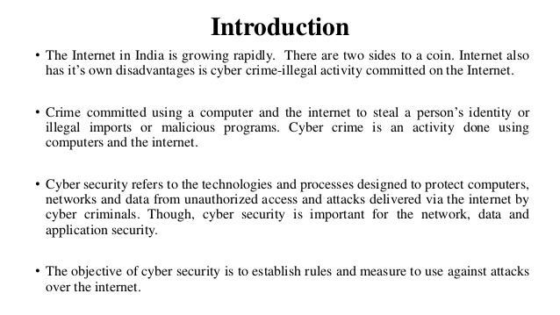

Slide 4
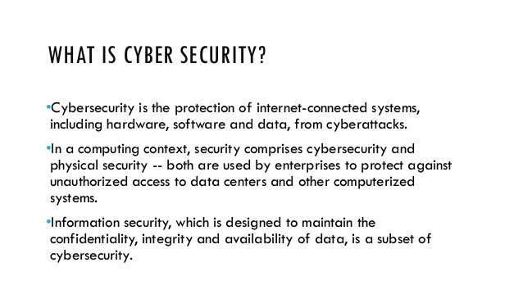

Slide 5
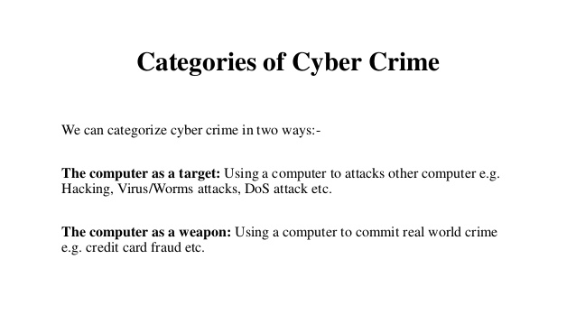

Slide 6
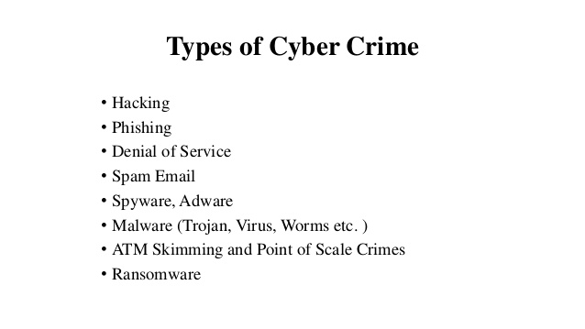

Slide 7
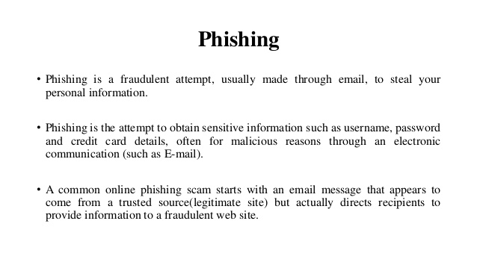

Slide 8
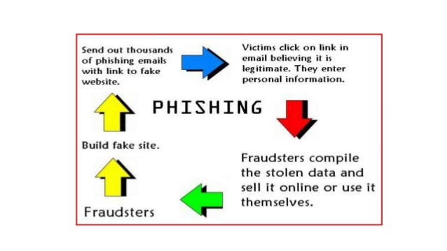

Slide 9
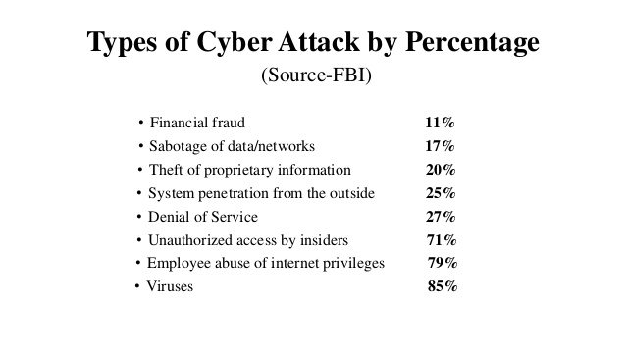

Slide 10
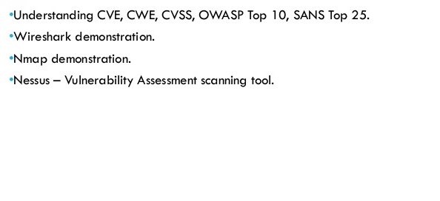
Types of Security Tools

Slide 11
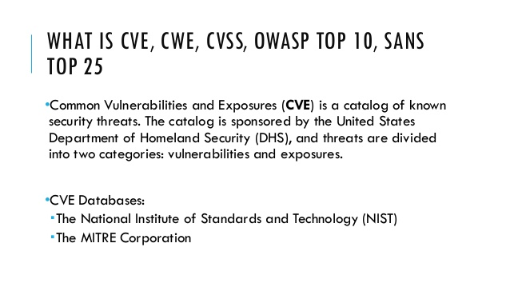

Slide 12
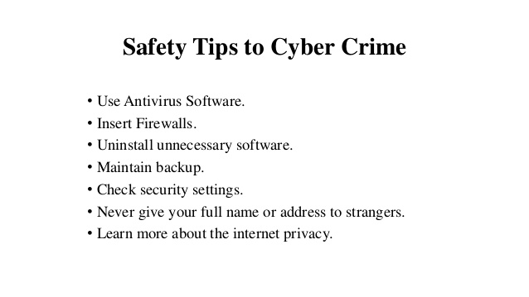

Slide 13
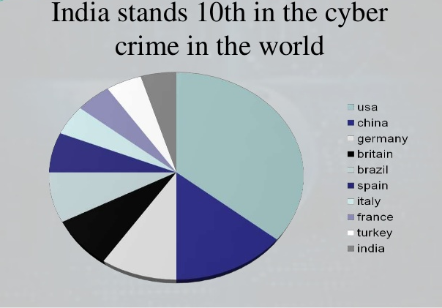

Slide 14
References
www.Wikipedia.org
www.avtest.org
www.billmullins.blogspot.com
www.digit/forum.com
www.antivirusnews.com

Slide 15


